Slide 1
Topological Models for Safety Analysis
Dan Maljovec
5/10/19

Slide 2
Problem Space Description
Input Parameter Candidates
+ Target Output(s)
Sample
Decision
Space-Filling Design
Design of Experiments
Adaptive Sampling/Active Learning
Collecting Available Data
Model
Analyze
Statistics
Correlation
Sensitivity
Validation
Visualization
Classification/Regression Model
Structural Model
Statistical Modeling
Reduced Order Modeling
Notes:
So, scientific research at its most basic level is about observing phenomena occuring in nature and our surroundings through relationships of different quantities of interest. For our purposes, we are interested in studying the relationship between some input parameters that we have direct control over and observable target outputs, we believe to be correlated to a subset of those inputs. We perform our experimental design and the end result is some enhanced approximation or theory about the relationship.
We are interested in what is happening in this middle box, so if we lift the covers and look a bit more closely we see three major componenets of the experimental design process: Explore, Analyze, and Synthesize.

Slide 3
Problem Space Description
Input Parameter Candidates
+ Target Output(s)
Sample
Topology
Model
Analyze
Decision
Notes:
So, scientific research at its most basic level is about observing phenomena occuring in nature and our surroundings through relationships of different quantities of interest. For our purposes, we are interested in studying the relationship between some input parameters that we have direct control over and observable target outputs, we believe to be correlated to a subset of those inputs. We perform our experimental design and the end result is some enhanced approximation or theory about the relationship.
We are interested in what is happening in this middle box, so if we lift the covers and look a bit more closely we see three major componenets of the experimental design process: Explore, Analyze, and Synthesize.

Slide 4
Sampling Publications
Input Parameter Candidates
+ Target Output(s)
Sample
Adaptive Sampling with Topological Scores.
D. Maljovec, B. Wang, A. Kupresanin, G. Johannesson, V. Pascucci, and P-T Bremer. IJUQ, 3(2), pages 119-141, 2013
Adaptive Sampling Algorithms for Probabilistic Risk Assessment of Nuclear Simulations.
D. Maljovec, B. Wang, D. Mandelli, P-T Bremer, and V. Pascucci. PSA, 2013.
*First Runner-up for Best Student Paper Award
Model
Analyze
Decision
Notes:
So, scientific research at its most basic level is about observing phenomena occuring in nature and our surroundings through relationships of different quantities of interest. For our purposes, we are interested in studying the relationship between some input parameters that we have direct control over and observable target outputs, we believe to be correlated to a subset of those inputs. We perform our experimental design and the end result is some enhanced approximation or theory about the relationship.
We are interested in what is happening in this middle box, so if we lift the covers and look a bit more closely we see three major componenets of the experimental design process: Explore, Analyze, and Synthesize.

Slide 5
Analysis Publications
Rethinking Sensitivity Analysis of Nuclear Simulations with Topology.
D. Maljovec, B. Wang, P. Rosen, A. Alfonsi, G. Pastore, C. Rabiti, and V. Pascucci. PacificVis, 2016.
Visualizing High-Dimensional Data: Advances in the Past Decade.
*D. Maljovec, *S. Liu, B. Wang, P-T Bremer, and V. Pascucci. Eurographics Conference on Visualization (EuroVis), STAR - State of the Art Report, 2015. *Joint First Authors
Analyzing Simulation-Based PRA Data Through Clustering: a BWR SBO Case Study.
D. Maljovec, S. Liu, B. Wang, V. Pascucci, P-T Bremer, D. Mandelli and C. Smith. PSAM, 2014. Extended Journal version: Reliability Engineering & System Safety (RESS), 2015.
Analyzing Dynamic Probabilistic Risk Assessment Data through Clustering.
D. Maljovec, B. Wang, D. Mandelli, P-T Bremer, and V. Pascucci. PSA, 2013.
ND²AV: an Analysis for the National Ignition Campaign.
P-T Bremer, D. Maljovec, A. Saha, B. Wang, J. Gaffney, B. Spears, and V. Pascucci. Computing and Visualization in Science, 17(1), Pages 1-18, 2015
Exploration of High-Dimensional Scalar Function for Nuclear Reactor Safety Analysis and Visualization.
D. Maljovec, B. Wang, V. Pascucci, P-T Bremer, M. Pernice, D. Mandelli, and R. Nourgaliev, M&C 2013
Input Parameter Candidates
+ Target Output(s)
Sample
Model
Analyze
Decision
Notes:
So, scientific research at its most basic level is about observing phenomena occuring in nature and our surroundings through relationships of different quantities of interest. For our purposes, we are interested in studying the relationship between some input parameters that we have direct control over and observable target outputs, we believe to be correlated to a subset of those inputs. We perform our experimental design and the end result is some enhanced approximation or theory about the relationship.
We are interested in what is happening in this middle box, so if we lift the covers and look a bit more closely we see three major componenets of the experimental design process: Explore, Analyze, and Synthesize.

Slide 6
Modeling Publications
On the Applicability of Proximity Graphs for Multidimensional Data Analysis.
D. Maljovec, D. Wang, P-T Bremer, and V. Pascucci, SciVis 2019.
Scalable Topological Data Analysis and Visualization for Evaluating Data-Driven Models in Scientific Applications.
S. Liu, D. Wang, D. Maljovec, R. Anirudh, J. Thiagarajan, S. Jacobs, B. Van Essen, D. Hysom, J-S Yeom, J. Gaffney, J.L. Peterson, P. Robinson, H. Bhatia, V. Pascucci, B. Spears, and P-T. Bremer, VAST 2019).
*Under Review
Reduced Order Model and PRA: A Multi-Unit Perspective.
D. Mandelli, D. Maljovec, and A. Alfonsi. ANS Winter Mtg 2018.
Integration of Fault-Trees and Event-Trees into Dynamic PRA.
D. Mandelli, D. Maljovec, A. Alfonsi, C. Wang, Z. Ma, C. Parisi, and C. Smith. ANS Summer Mtg 2018.
An Overview of Reduced Order Modeling Techniques for Safety Applications.
D. Mandelli, A. Alfonsi, P. Talbot, C. Wang, D. Maljovec, C. Smith, C. Rabiti. ESREL 2017.
Input Parameter Candidates
+ Target Output(s)
Sample
Model
Analyze
Decision
Notes:
So, scientific research at its most basic level is about observing phenomena occuring in nature and our surroundings through relationships of different quantities of interest. For our purposes, we are interested in studying the relationship between some input parameters that we have direct control over and observable target outputs, we believe to be correlated to a subset of those inputs. We perform our experimental design and the end result is some enhanced approximation or theory about the relationship.
We are interested in what is happening in this middle box, so if we lift the covers and look a bit more closely we see three major componenets of the experimental design process: Explore, Analyze, and Synthesize.

Slide 7
Application/Decision Publications
Input Parameter Candidates
+ Target Output(s)
Mining Data in a Dynamic PRA Framework
D. Mandelli, D. Maljovec, A. Alfonsi, C. Parisi, P. Talbot, J. Cogliati, C. Smith, and C. Rabiti. Progress in Nuclear Energy, Volume 108, Pages 99-110, 2018.
Analysis of Time Dependent Data and PRA
D. Mandelli, D. Maljovec, A. Alfonsi, C. Picoco, C. Smith, and C. Rabiti. ANS Winter Mtg 2017.
High-Dimensionality Reduction for Multi-physics Application Under the RAVEN Framework
C. Wang, P. Talbot, C. Rabiti, A. Alfonsi, D. Mandelli, J. Cogliati, D. Maljovec, and R. Kinoshita. ANS Winter Mtg 2017.
An Overview of Methods to Analyze Dynamic PRA Data
D. Mandelli, D. Maljovec, C. Parisi, A. Alfonsi, C. Smith, Cristian Rabiti. ESREL 2017.
Dynamic PRA of a Multi-Unit Plant
D. Mandelli, C. Parisi, A. Alfonsi, D. Maljovec, S. St. Germain, R. Boring, S. Ewing, C. Smith, C. Rabiti. PSA 2017.
Sample
Model
Analyze
Decision
Notes:
So, scientific research at its most basic level is about observing phenomena occuring in nature and our surroundings through relationships of different quantities of interest. For our purposes, we are interested in studying the relationship between some input parameters that we have direct control over and observable target outputs, we believe to be correlated to a subset of those inputs. We perform our experimental design and the end result is some enhanced approximation or theory about the relationship.
We are interested in what is happening in this middle box, so if we lift the covers and look a bit more closely we see three major componenets of the experimental design process: Explore, Analyze, and Synthesize.

Slide 8


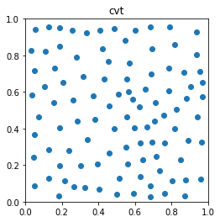
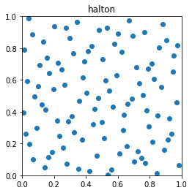
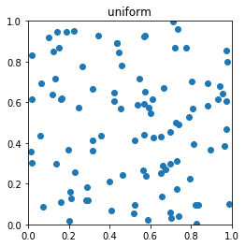
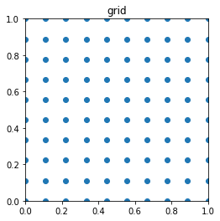
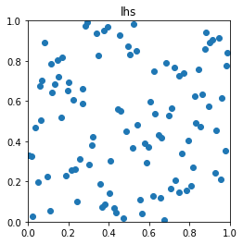
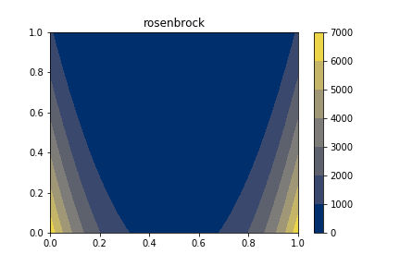
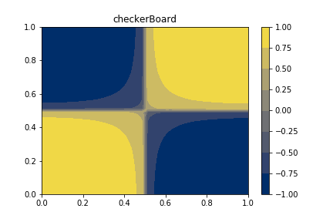
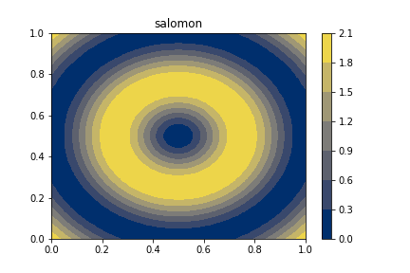

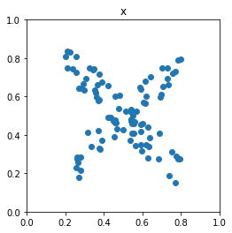
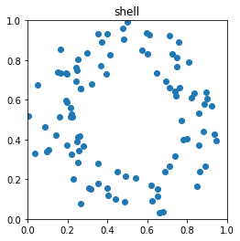
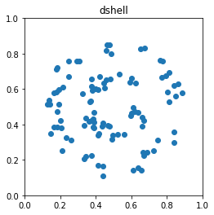
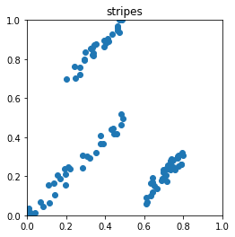
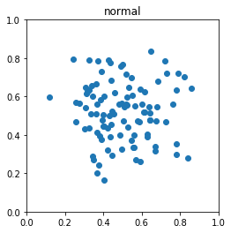
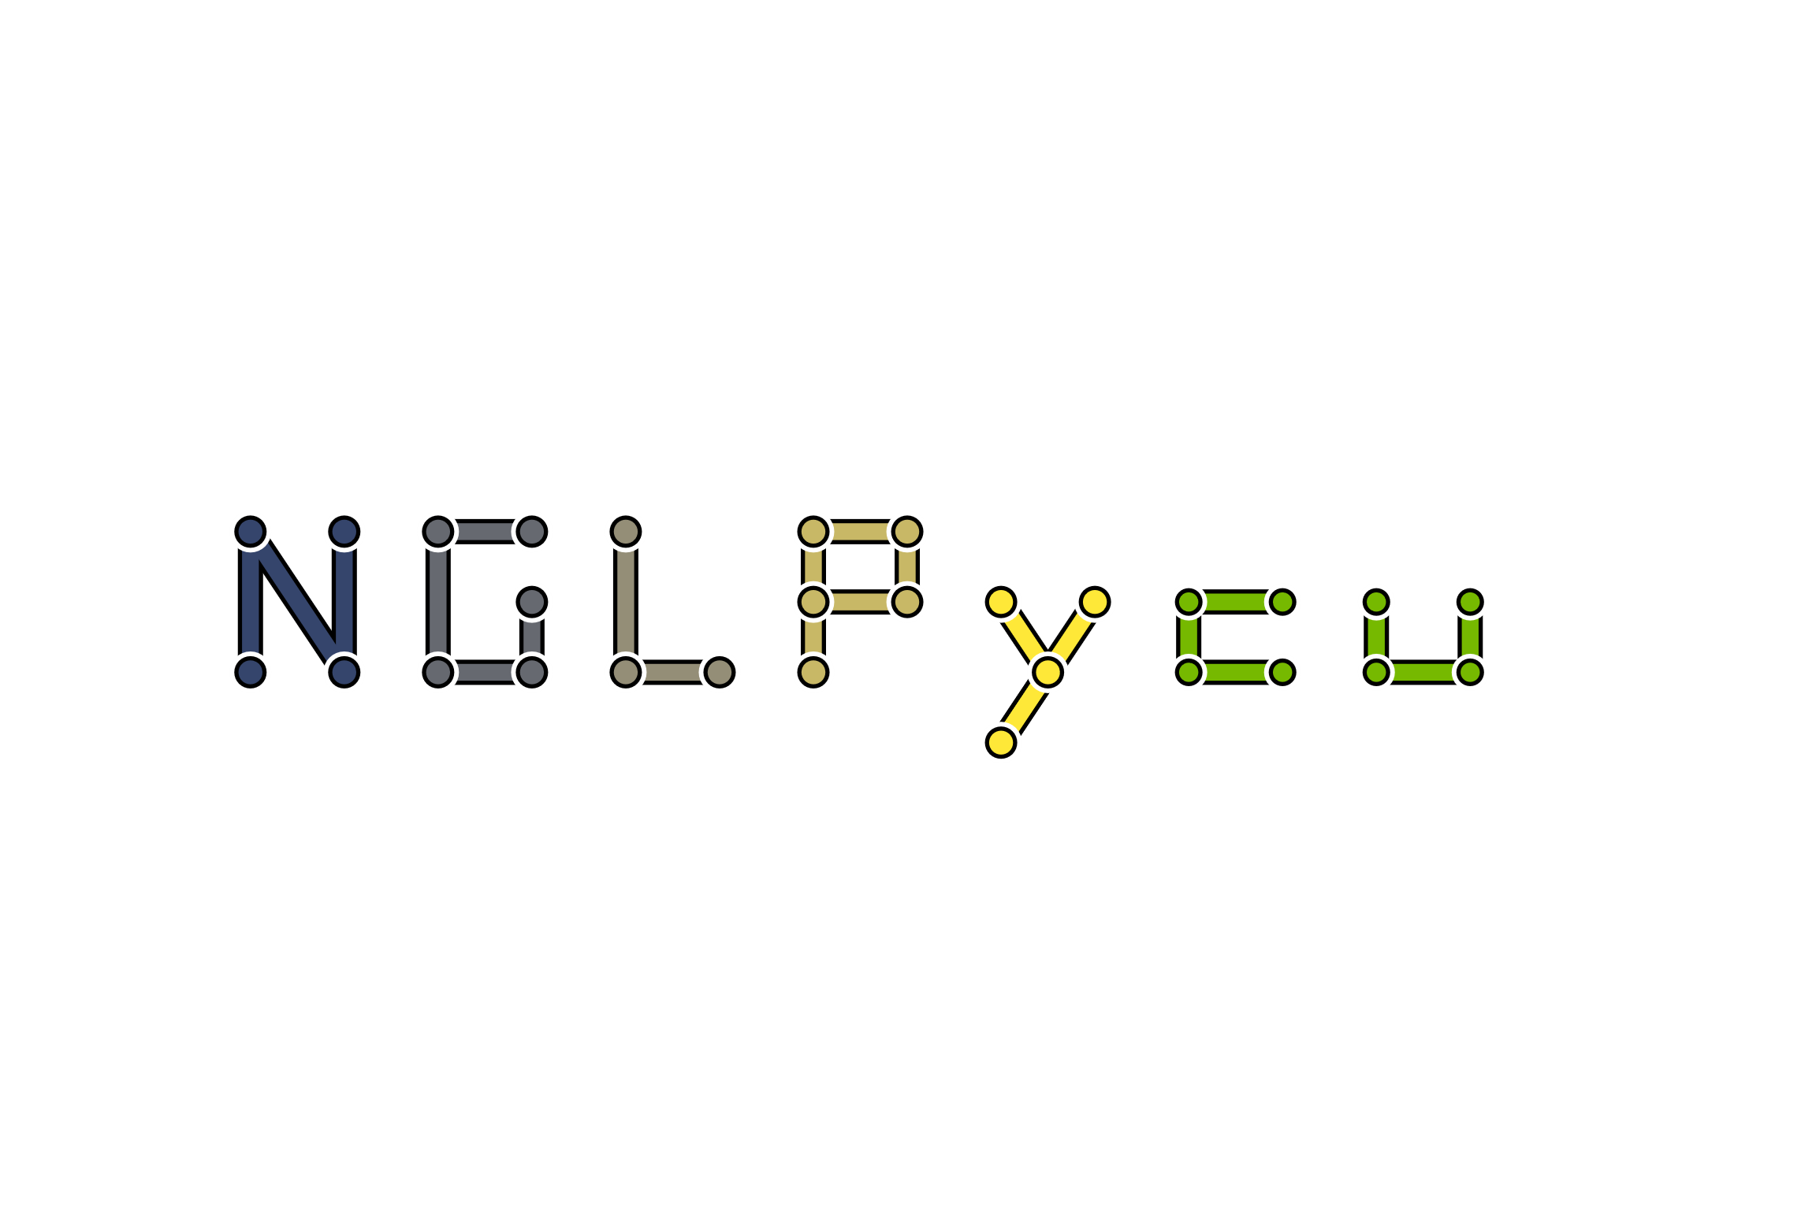
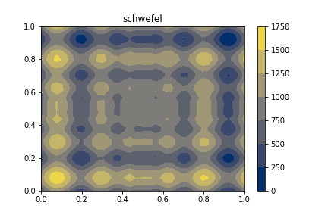
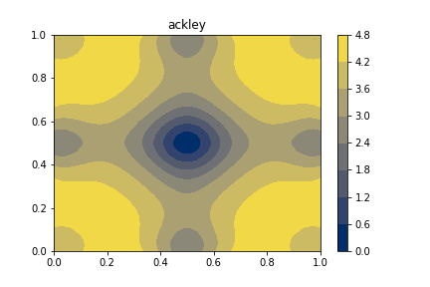
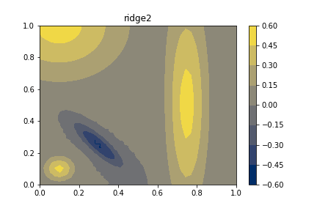
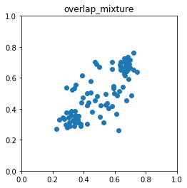
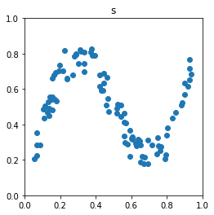
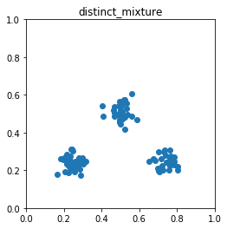
Contributions
17 Peer-Reviewed Publications + 1 Tech Report
7 First author papers
3 More under review (1 first author)
Contributed to 3 National Lab-sponsored Open Source Projects
Authored 4 Open Source Projects
NDN
2
Samply
FlatPy
Notes:
Here is a list of my current publications, and for today's talk I am going to focus on talking about only a few of them which I have highlighted here plus some additional yet to be published efforts.

Slide 9
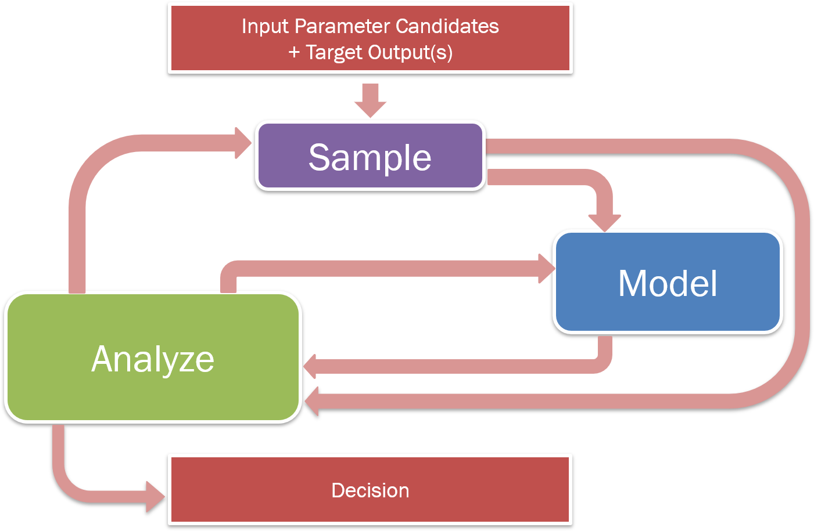
Topology Can Be Used at All Stages
Consider the input space as a manifold and the target as a smooth function defined on that space
Utilize Morse Theory to extract structure and features for sampling, modeling, and analysis
Topology
Notes:
In order to adapt methods from topology, we make a few assumptions on our data space namely: we consider the arbitray dimensional input space as a manifold, and the target outputs as smooth functions on that manifold space meaning anywhere on the manifold we can evaluate a target response value.
Specifically, we are going to consider a branch of differential topology called Morse theory to augment each of these three components: exploration, analysis, and synthesis.

Slide 10
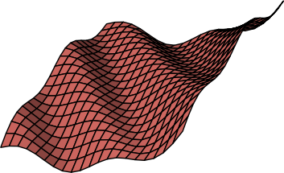

Background: Topology
Manifold
Something that resembles Euclidean space locally…everywhere
Smooth Function
Continuously defined and differentiable
high
f(x)
low
Notes:
To clarify, I want to define a few terms from the previous slide. A manifold is a space that locally resembles a Euclidean space of that dimensionality everywhere it is defined.
In addition, the target responses we are evaluating will be treated as smooth functions defined over the manifolds. This means at any location in the input manifold, the target and its derivative are continuously defined.

Slide 11
Background: Morse Theory
1
3
2
1
2
3
f(x)
Notes:
From Morse theory, we are interested in two key concepts illustrated here. So, consider the terrain on the left as a 2D manifold with height representing the function value. In the top image, we are tracking the evolution of levelsets. That is, when the topology of the levelsets changes. You see on the right image a tree view that shows each leaf as the birth or death of a connected component of the levelset and branches in the tree represent splits and merges of the connected components.
We see the vertical position of each node in the tree represents the isovalue at which that event occurs. So, if we choose an isovalue and cut the tree, we note that each intersection with the dashed line represents a seaparate component of the levelset.
In the lower example, we are showing a Morse-Smale complex which instead partitions the data based on gradient flow. In this example, every location is associated with the source and sink of the integral line that passes through it. So, if we consider the orange partition that is facing us, if we trace the gradient from any location upward we will end up at the blue maximum point occuring in the center of the image. Conversely, if we trace the negative gradient from any location on the orange patch, we will end up at the minimum occuring at the lower right of the image.

Slide 12
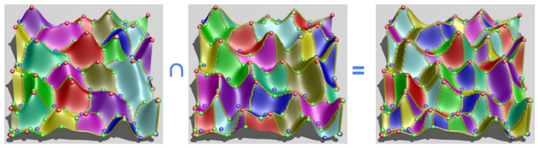
Background: Morse-Smale Complex
Stable/Descending
Manifolds
Unstable/Ascending
Manifolds
Morse-Smale
Complex

Slide 13
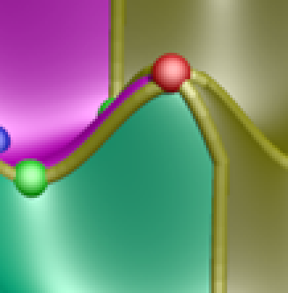
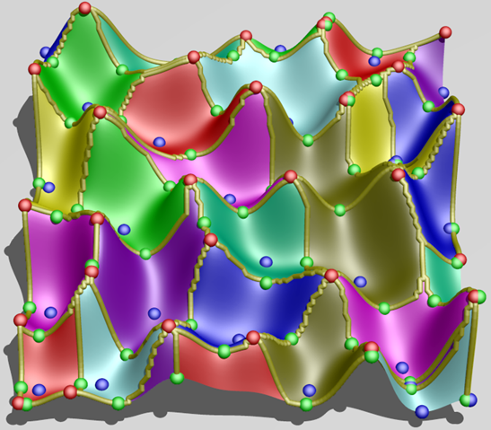
Computing the Morse Complex
Traditionally:
b. Follow steepest descent from each point in dataset
b. Color points based on minimum where flow halts

Slide 14
Approximating the Morse Complex
What if you don’t have a smooth representation?

Slide 15
Approximating the Morse Complex
What if you don’t have a smooth representation?

Slide 16
Approximating the Morse Complex
What if you don’t have a smooth representation?

Slide 17
Definition of Persistence
Critical Points:
maxima =
minima =
p_{c}
p_{a}
p_{b}
Notes:
A nice feature of the Morse-Smale complex is that we can associate a notion of feature scale. That is we can simplify or smooth away smaller features while maintaining the larger ones to arrive at a less resolved partitioning. This is done through a process known as persistence simplification.
Consider, this 1D function. Basically, we are going to pair neighboring critical points based on their smallest function value difference neighboring critical point (at the time of cancellation), and associate their function value difference as their combined persistence.
In this case, we first pair and cancel the small peak/valley combination on the left of this function.
Next, we pair the larger maximum and minimum together.
Lastly, we pair the local minimum and maximum occurring at the boundaries of the data. Note, that the last pair are not adjacent in the function, but since we have cancelled all of the other critical points they are now considered adjacent.

Slide 18
Sampling Contributions
Topology-based scoring
Limit surface sampling
Batch candidate selection
Adaptive Sampling with Topological Scores.
D. Maljovec, B. Wang, A. Kupresanin, G. Johannesson, V. Pascucci, and P-T Bremer. IJUQ, 3(2), pages 119-141, 2013
Adaptive Sampling Algorithms for Probabilistic Risk Assessment of Nuclear Simulations.
D. Maljovec, B. Wang, D. Mandelli, P-T Bremer, and V. Pascucci. PSA, 2013.
*First Runner-up for Best Student Paper Award
Notes:
Okay, so now with the necessary background in hand, we will begin by seeing how we can inject some of these concepts into the exploration phase.

Slide 19
Challenges in Sampling Experimental Spaces
We want the most out of the least amount of information since data is hard to come by:
Expensive
Time-consuming
Dangerous
Data can exist in high-dimensional space:
Exponential increase of volume as dimension increases
Notes:
Given the nature of nuclear energy, it should come as no surprise that physical experimentation can be very dangerous, and so often we rely on computer simulations. However, due to the complexity of the physics we are modeling, collecting copious amounts of data can still be expensive and time-consuming. Therefore, it is to our advantage to extract the most amount of information from the least amount of data.
Furthermore, the input spaces we are interested can be of arbitrary input dimensionality, and from the curse of dimensionality we know that the space needed to sample grows exponentially with respect to increasing dimensionality. So, it is unlikely that we will ever recover a dense enough sampling in high-dimensions to do a meaningful global analysis.

Slide 20
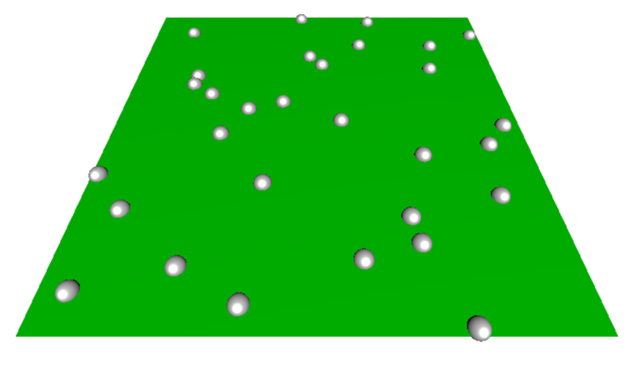
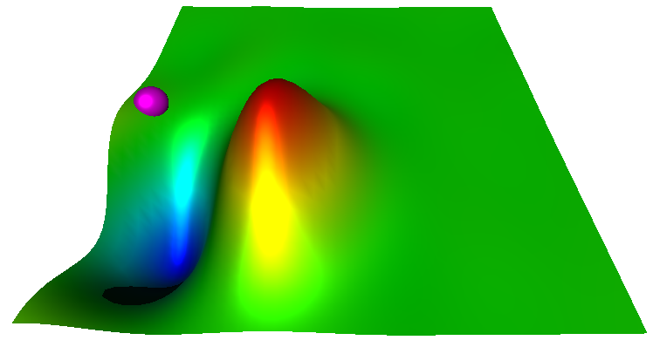
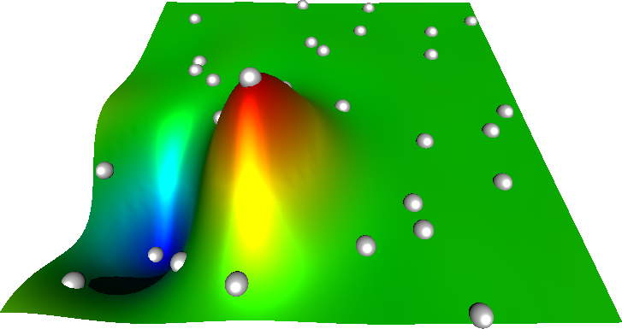
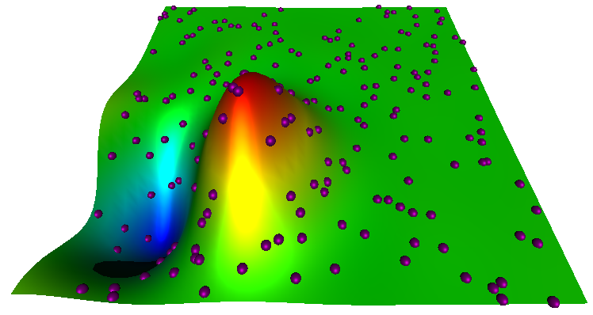
Changing the Adaptive Sampling Cycle
Run experiment at training location(s)
Fit a predicting model
Generate & score candidates
Select candidate for training
Notes:
Here, I am showing a typical adaptive sampling pipeline used for initial data sampling. We begin with no knowledge of our response value of interest and so select several training data locations based on some space-filling design, and evaluate our ground truth model on it.
We fit a predicting model to the obtained data.
We next generate a pool of candidates and based on information from the predicting model we score these candidates to determine which candidate will give us the most useful information. We then select a candidate, evaluate it using the ground truth, and add it to our training data and repeat the process.
So, of these four steps I want to focus our attention on these last two steps: namely how we score and select candidates for training.

Slide 21
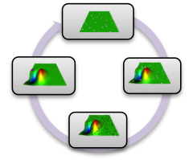
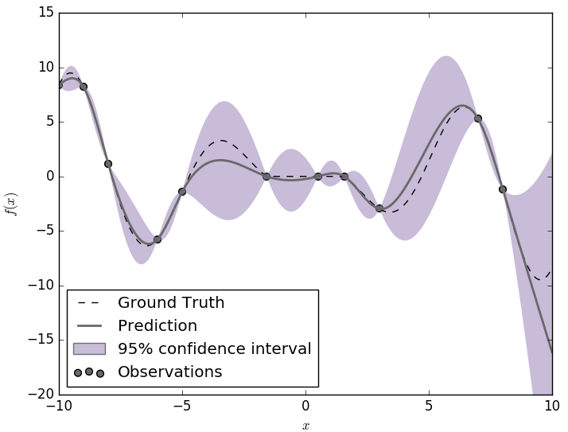
Comparing Scoring Methods
High uncertainty in the current predicting model
Expected improvement (steep gradient + uncertainty)
Topology-based scoring
Notes:
Many predicting models are probabilistic or can be made probablistic by methods such as boostrap aggregating. In this way, we can associate an uncertainty with each location in our input space.
Here, we consider a 1D problem fit with a probabilistic model.
McKay et al. introduced a method geared at targeting highly uncertain regions. So, we can see in this example, that we want to select candidates that have large error bars associated with them. The problem here is that sometimes this methodology can waste effort looking in regions where the predicting model is relatively flat and uninteresting.
Thus, a similar method was introduced later that targets not only uncertain regions, but also areas of steep gradient. This was termed the expected improvement function. In this case, we combine the difference in mean value prediction of a candidate with its nearest neighboring training point with the uncertainty of the predicting model.
This last method starts to get at a key component of adaptive sampling, that is can we avoid "flat" regions and instead place samples where the function is doing something more interesting.
In understanding this concept, we developed several scoring metrics that were more directly geared at this by exploiting the topology of the predicting model directly in order to identify areas of high persistence features, or where adding a point will likely affect the overall global topology.

Slide 22
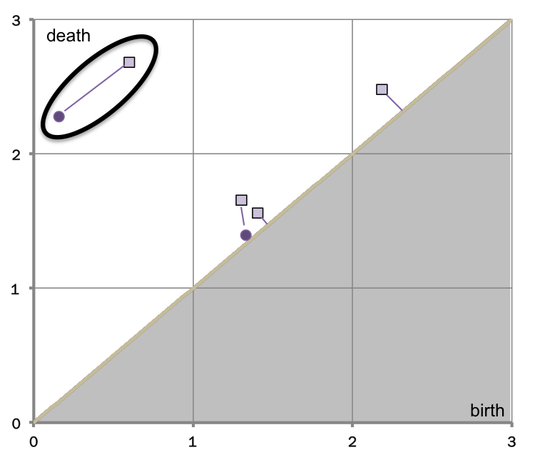
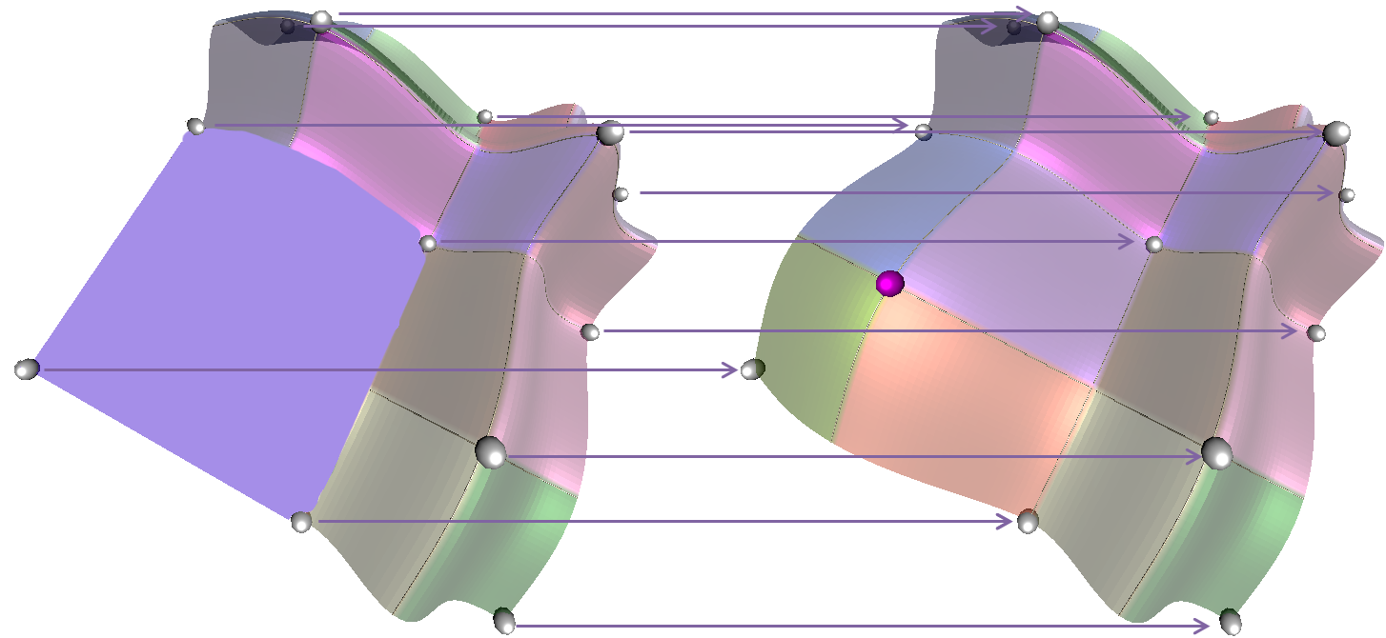
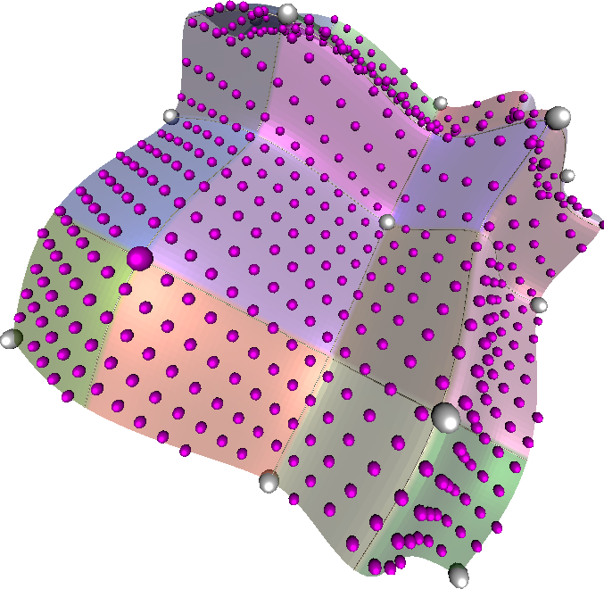
Comparing Scoring Methods
High uncertainty in the current predicting model
Expected improvement (steep gradient + uncertainty)
Topology-based scoring
Global Topological Influence
Local Topological
Influence
Σ(Δp)/n
Adaptive Sampling with Topological Scores. Dan Maljovec, Bei Wang, Ana Kupresanin, Gardar Johannesson, Valerio Pascucci, and Peer-Timo Bremer. International Journal for Uncertainty Quantification, 3(2), pages 119-141, 2013
Notes:
And so, we developed 3 novel scoring functions based on the Morse-Smale complex that attempted to capture these topological changes in different ways: by looking for which candidate globally affected the topology the most, and also by highlighting the most topologically significant candidate.
This work is highlighted in our 2013 IJUQ paper titled Adaptive Sampling with Topological Scores.

Slide 23
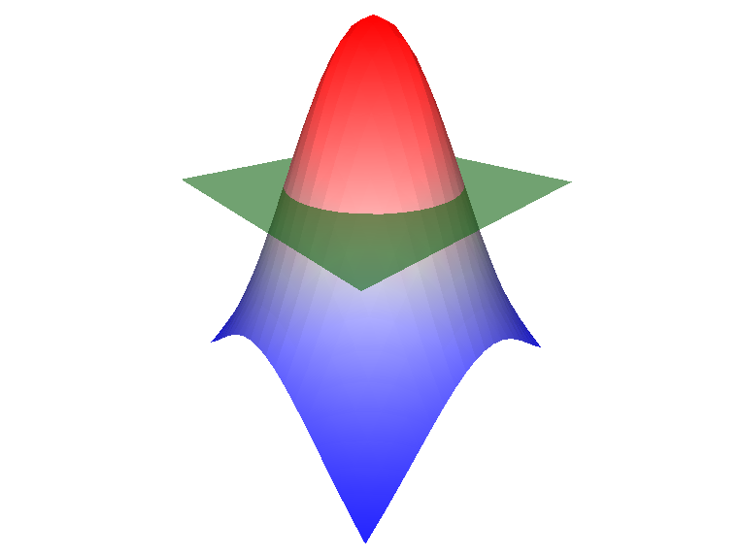
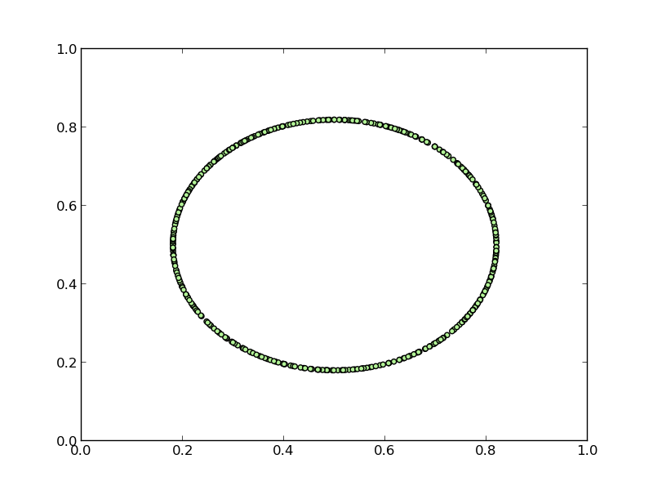
Limit Surface Restricted Adaptive Sampling
Failure region
Limit surface
Notes:
Let me take a brief second to discuss a slightly different problem that nuclear engineers often deal with. Our last study, looked at adaptive sampling with the goal of obtaining a globally accurate fit of the data.
Often in the nuclear accident analysis, they are dealing with simulations where the goal is to understand the frontier that separates recoverable scenarios from system failure scenarios. The frontier we seek is known as the limit surface and the often the goal is to understand the probability of failure which amounts to determining the integral over the failure region.
In order to characterize the limit surface, they often rely on adaptive sampling methods.

Slide 24
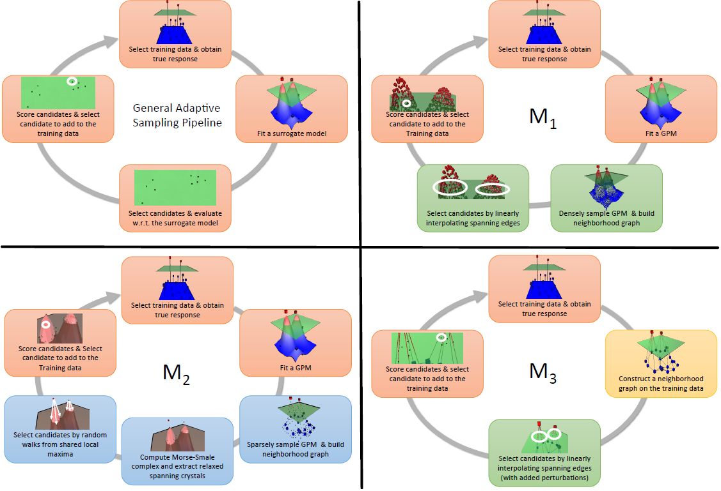
Pipelines for Limit Surface Adaptive Sampling
Notes:
For the limit surface problem, we actually took a different approach and built three variations of the adaptive sampling pipeline from a prior slide. Two of these methods represent more exploitive models similar to what we have done before, and so in the interest of time, I will highlight what is referred to here as M2.

Slide 25
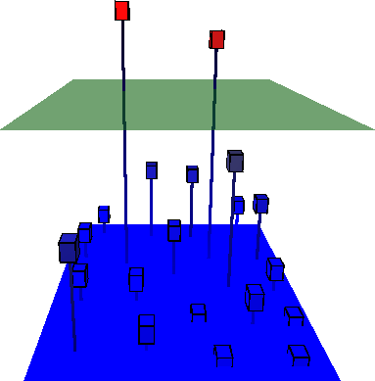
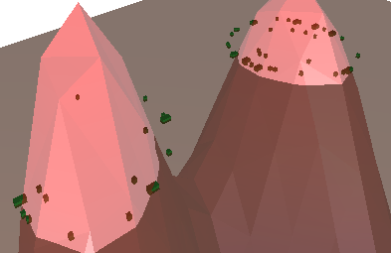
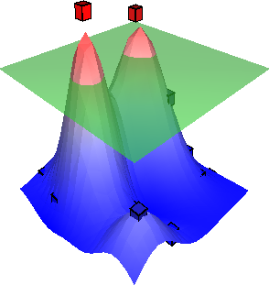
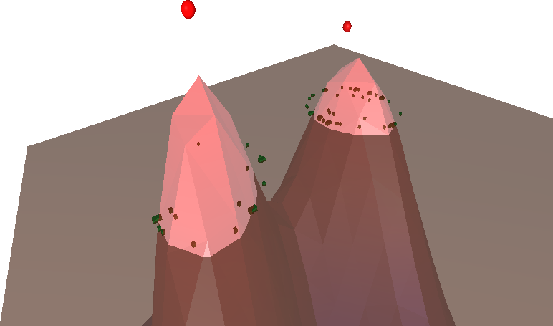
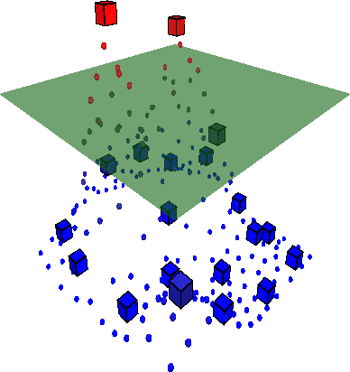
Topology-Aware Limit Surface Adaptive Sampling
Select training data & obtain true response
Score candidates & Select candidate to add to the Training data
Fit a Predicting Model (PM)
Select candidates by random walks from shared local maxima
Sparsely sample PM & build neighborhood graph
Compute Morse complex and extract relaxed spanning crystals
Notes:
This model computes the Morse complex of the data and then utilizes a relaxation parameter to search for partitions in the data that either span or "nearly" span the threshold value. In this way, we can explore regions where the maximum of a dataset may be close to the threshold.

Slide 26
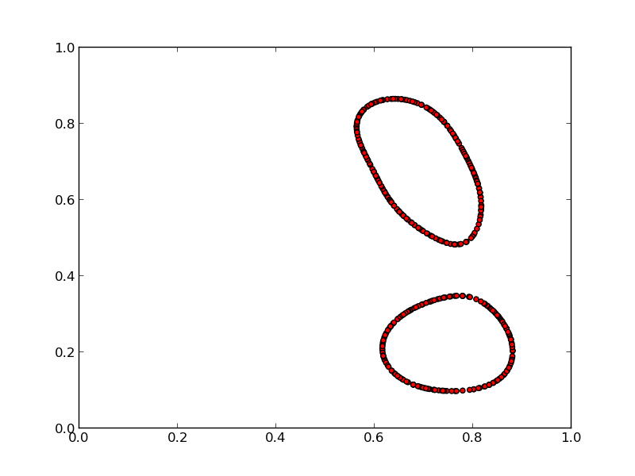
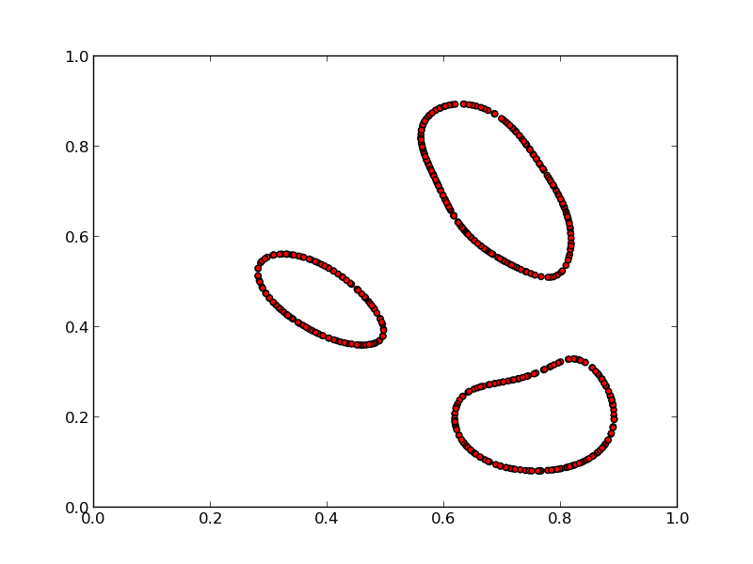
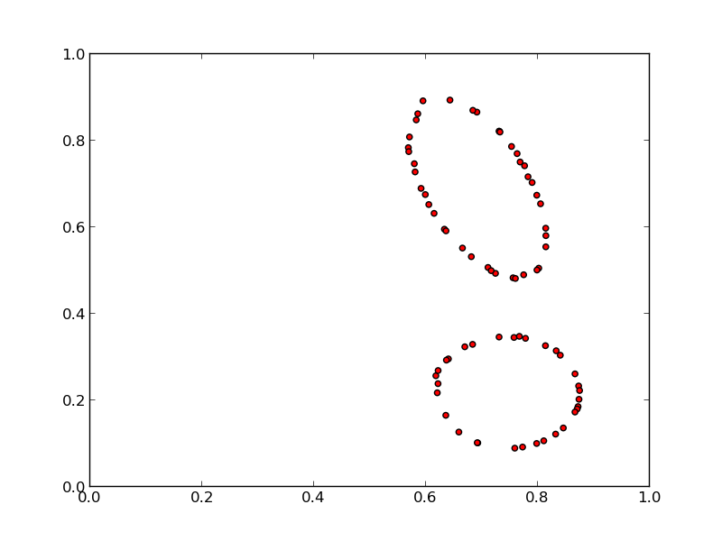
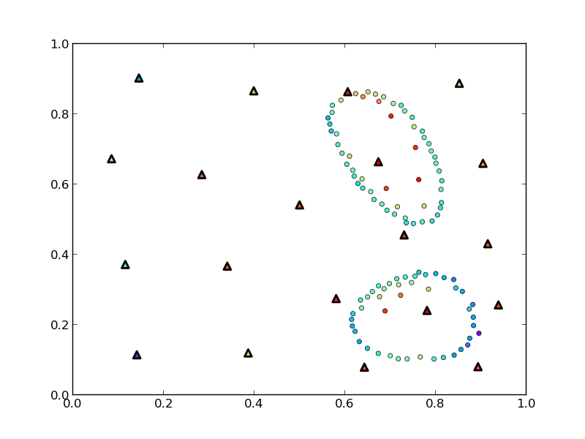
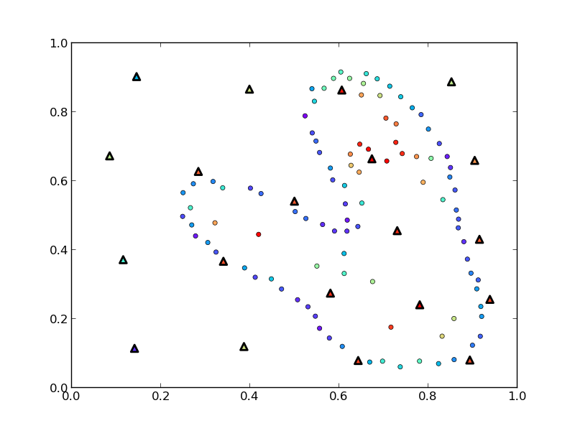
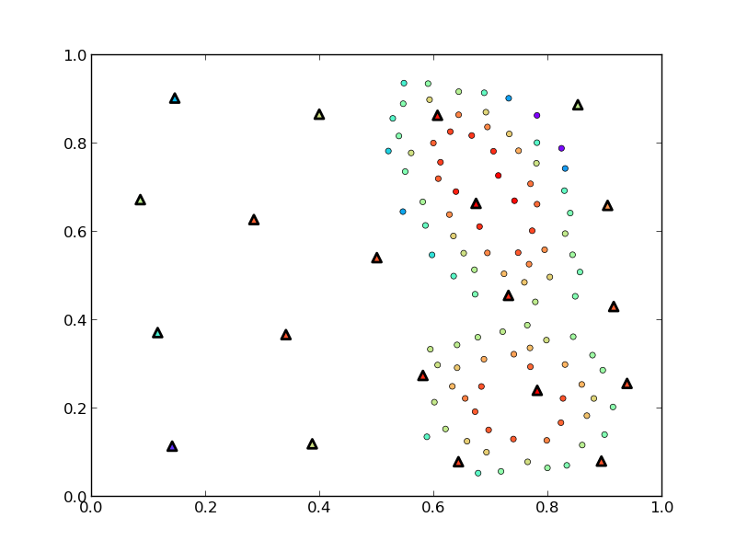
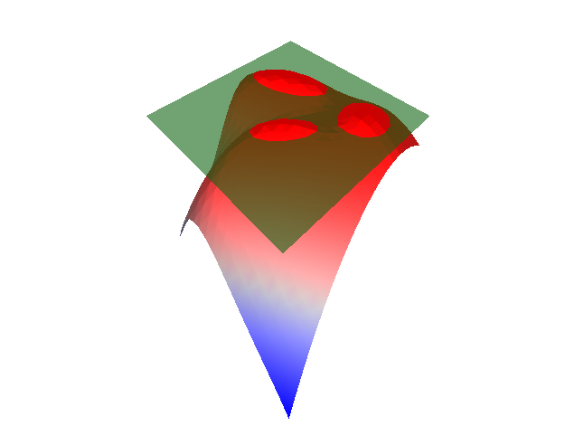
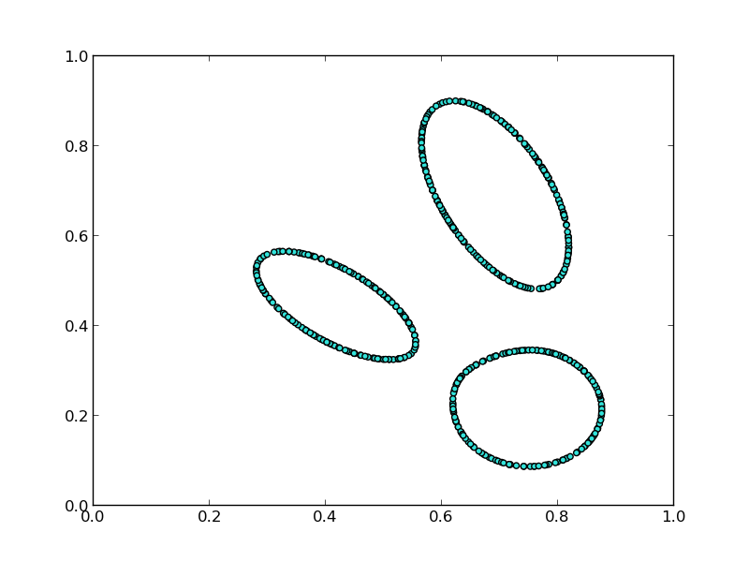
Topology Finds What Traditional Techniques Miss
Explore vs. Exploit
M1
M2
M3
Adaptive Sampling Algorithms for Probabilistic Risk Assessment of Nuclear Simulations.
Dan Maljovec, Bei Wang, Diego Mandelli, Peer-Timo Bremer, and Valerio Pascucci. International Topical Meeting on Probabilistic Safety Assessment and Analysis (PSA), 2013.
*First Runner-up for Best Student Paper Award
True Limit Surface
Notes:
We see that with the appropriate relaxation setting, this model is actually able to identify a component of the true limit surface that was not captured in the initial training data.
This work was presented in a nuclear engineering conference and was runner-up for the best student paper award.

Slide 27
Analysis Contributions
Structured sensitivity analysis
Understanding approximation errors/limitations of topology
Various applications: nuclear safety, civil engineering, nuclear fusion research
Rethinking Sensitivity Analysis of Nuclear Simulations with Topology.
D. Maljovec, B. Wang, P. Rosen, A. Alfonsi, G. Pastore, C. Rabiti, and V. Pascucci. PacificVis, 2016.
Visualizing High-Dimensional Data: Advances in the Past Decade.
*D. Maljovec, *S. Liu, B. Wang, P-T Bremer, and V. Pascucci. Eurographics Conference on Visualization (EuroVis), STAR - State of the Art Report, 2015. *Joint First Authors
Analyzing Simulation-Based PRA Data Through Clustering: a BWR SBO Case Study.
D. Maljovec, S. Liu, B. Wang, V. Pascucci, P-T Bremer, D. Mandelli and C. Smith. PSAM, 2014. Extended Journal version: RESS, 2015.
Analyzing Dynamic Probabilistic Risk Assessment Data through Clustering.
D. Maljovec, B. Wang, D. Mandelli, P-T Bremer, and V. Pascucci. PSA, 2013.
ND²AV: an Analysis for the National Ignition Campaign.
P-T Bremer, D. Maljovec, A. Saha, B. Wang, J. Gaffney, B. Spears, and V. Pascucci. Computing and Visualization in Science, 17(1), Pages 1-18, 2015
Exploration of High-Dimensional Scalar Function for Nuclear Reactor Safety Analysis and Visualization.
D. Maljovec, B. Wang, V. Pascucci, P-T Bremer, M. Pernice, D. Mandelli, and R. Nourgaliev, M&C 2013
Notes:
We now move on to discuss work being performed in the analysis phase.

Slide 28




Previous Work of Sensitivity Analysis in Visualization
Global SA
Structured SA
Summary metrics over entire data
First step for further exploration
Partition data, then analyze
Handles non-monotonic data
Provides per partition summary
Crossno et al. 2015
Local SA
Sensitivity centered around focal point
Drilldown tasks
Muhlbacher and Piringer 2013
Complicated
Gerber et al. 2011
Berger et al. 2011
Notes:
So, typically the first go-to is a global sensitivity study and we have seen methods in visualization that do this for arbitrary input dimensions. These methods are great for parameter screening, however these types of methods struggle on non-monotonic data unless higher order methods are used, but these lack the direct interpretability of simple partial derivative type information.
On the other hand, local sensitivity analysis looks at a user-defined focal point giving a much more local and on-demand view of the information. These methods are better suited for drilldown techniques such as when one has identfied an area of interest or in optimization settings.
In terms of structured sensitivity, there has been past work, but these rely on 1 or 2D axis-aligned cuts of the data. The exception being the use of the Morse-Smale complex by Sam Gerber et al. which is where we want to focus our attention.
Here, I am highlighting the 2011 work that developed this software called HDViz. I utilized this technique in some of my earlier analysis with nuclear engineers, however after several iterations the nuclear engineers still relied heavily on expert users of the system, and so the idea of this work was to develop something intuitive and usable by the domain scientists directly.

Slide 29

We Can Use Topology for Structured SA
Sensitivity coefficients:
Linear
Pearson
Spearman rank
Stepwise Fitness:
Coefficient of determination (R²)
New Topology map
Notes:
I then started working at INL and performed an informal design study with a team of nuclear engineers focusing on the problem space they were interested in explicitly and how we could design visual metaphors that optimized their time using the software. The result of that design study is shown on this slide, namely a MCV piece of software explicitly for sensitivity analysis and parameter screening tasks.

Slide 30


SA Anomaly in Nuclear Fuel Simulations
?
Sign of thermal expansion coefficient sensitivity is reversed to the expected result
Rethinking Sensitivity Analysis of Nuclear Simulations with Topology.
Dan Maljovec, Bei Wang, Paul Rosen, Andrea Alfonsi, Giovanni Pastore, Cristian Rabiti, and Valerio Pascucci. Proceedings of IEEE Pacific Visualization (PacificVis), 2016.
Conclusion: Simulation input is incorrectly coded.
Notes:
So, the engineers used this tool to analyze the nuclear fuel data from before, and within 10 minutes, they were able to select an appropriate partition level and identified an anomaly in the data with respect to their expectation. The sign of one of the parameters was actually inverse of what they had expected, and so, we looked more closely at one of the simulations and noted that there was an error in the input deck that we were perturbing in order to generate this dataset.
It is important to note that in this process we cycled through an entire iteration of the experimental design process where we were able to identify an error and correct. For the sake of time, I am going to omit the corrected analysis on this data.

Slide 31

Morse-Smale Approximation Errors
The extracted topology depends on the graph
Notes:
When evaluating this data, it is important to not that we are using an approximation of the Morse-Smale complex dependent on the amount of data we have. That is, we approximate gradient flow based on a neighborhood graph imposed on the data.

Slide 32
Morse-Smale Approximation Errors
The extracted topology depends on the graph
Extraneous extrema due to under-connected graph
Notes:
This can lead to one of two problems in the approximation. The first is the result of having too few edges in the data. In the extreme case, this will create islands of data that are disjoint and unable to be analyzed, however the more common case results in spurious extrema as shown here.
In many cases, we can alleviate this problem with persistence simplifcation, but only if the feature scale is small.

Slide 33
Morse-Smale Approximation Errors
The extracted topology depends on the graph
Missed extrema due to over-connected graph
Notes:
The other case results from an over-connected graph which completely misses the existence of extrema by edges that basically "skip over" saddle locations.
We performed several empirical tests on 2-5D test cases which were compiled into a Workshop paper in 2013.

Slide 34


Persistence Alone Cannot Save Us
This happens in real-world datasets
Rethinking Sensitivity Analysis of Nuclear Simulations with Topology.
Dan Maljovec, Bei Wang, Paul Rosen, Andrea Alfonsi, Giovanni Pastore, Cristian Rabiti, and Valerio Pascucci. Proceedings of IEEE Pacific Visualization (PacificVis), 2016.
A Comparative Study of Morse Complex Approximation Using Different Neighborhood Graphs. Dan Maljovec, Avishek Saha, Peter Lindstrom, Peer-Timo Bremer, Bei Wang, Carlos Correa, and Valerio Pascucci. Topology-Based Methods in Visualization (TopoInVis), 2013.
Watershed-Scale Life Cycle Assessment Of Rainwater Harvesting Systems to Control Combined Sewer Overflows.
Hassan Tavakol-Davani, PhD Thesis. University of Utah, 2016.
Nuclear Fuel Data
Hydrology Data
Notes:
In two different real world datasets, one of which we have seen already, the domain scientists discovered partitions they did not expect, and upon closer inspection appeared to be the result of poor sampling density in the regions of interest.
In this way, persistence simplification alone is unable to remove such features from the data.
One avenue of proposed work yet to be completed is to call attention to such problems and rely on a more user-guided interaction of the topology that allows them to explore certain branches of the hierarchy in exclusion and augment them manually if necessary.
In addition, I would like to explore the idea of further decomposing the monotonic patches of the Morse-Smale complex since monotonicity does not ensure an accurate linear fit.

Slide 35
Persistence Alone Cannot Save Us
This happens in real-world datasets
Notes:
In two different real world datasets, one of which we have seen already, the domain scientists discovered partitions they did not expect, and upon closer inspection appeared to be the result of poor sampling density in the regions of interest.
In this way, persistence simplification alone is unable to remove such features from the data.
One avenue of proposed work yet to be completed is to call attention to such problems and rely on a more user-guided interaction of the topology that allows them to explore certain branches of the hierarchy in exclusion and augment them manually if necessary.
In addition, I would like to explore the idea of further decomposing the monotonic patches of the Morse-Smale complex since monotonicity does not ensure an accurate linear fit.

Slide 36
Model Contributions
Considering alternative graphs
GPU framework
Comparing proximity graphs in practice
On the Applicability of Proximity Graphs for Multidimensional Data Analysis.
D. Maljovec, D. Wang, P-T Bremer, and V. Pascucci, SciVis 2019.
Scalable Topological Data Analysis and Visualization for Evaluating Data-Driven Models in Scientific Applications.
S. Liu, D. Wang, D. Maljovec, R. Anirudh, J. Thiagarajan, S. Jacobs, B. Van Essen, D. Hysom, J-S Yeom, J. Gaffney, J.L. Peterson, P. Robinson, H. Bhatia, V. Pascucci, B. Spears, and P-T. Bremer, VAST 2019).
*Under Review
Reduced Order Model and PRA: A Multi-Unit Perspective.
D. Mandelli, D. Maljovec, and A. Alfonsi. ANS Winter Mtg 2018.
Integration of Fault-Trees and Event-Trees into Dynamic PRA.
D. Mandelli, D. Maljovec, A. Alfonsi, C. Wang, Z. Ma, C. Parisi, and C. Smith. ANS Summer Mtg 2018.
An Overview of Reduced Order Modeling Techniques for Safety Applications.
D. Mandelli, A. Alfonsi, P. Talbot, C. Wang, D. Maljovec, C. Smith, C. Rabiti. ESREL 2017.
Notes:
We now move on to discuss work being performed in the analysis phase.

Slide 37
What Other Graphs Can We Use?
k-Nearest Neighborhood
k is sensitive to dimensionality and density of points
(can be hard to get right)

Slide 38
What Other Graphs Can We Use?
k-Nearest Neighborhood
β-Skeletons
β<1
p
q

Slide 39
What Other Graphs Can We Use?
k-Nearest Neighborhood
β-Skeletons
β<1
β=1 (Gabriel Graph)
p
q

Slide 40
What Other Graphs Can We Use?
k-Nearest Neighborhood
β-Skeletons
β<1
β=1 (Gabriel Graph)
1<β<2
β=2 (Relative Neighbor Graph)
*Increasing β,
Decreases edge density
p
q

Slide 41
What Other Graphs Can We Use?
k-Nearest Neighborhood
β-Skeletons
β<1
β=1 (Gabriel Graph)
1<β<2
β=2 (Relative Neighbor Graph)
Relaxed β-Skeletons
*Increasing β,
Decreases edge density
c
b
a

Slide 42
What Other Graphs Can We Use?
k-Nearest Neighborhood
β-Skeletons
β<1
β=1 (Gabriel Graph)
1<β<2
β=2 (Relative Neighbor Graph)
Relaxed β-Skeletons
Cone Graphs
m-Yao Graph
*Increasing β,
Decreases edge density

Slide 43
What Other Graphs Can We Use?
k-Nearest Neighborhood
β-Skeletons
β<1
β=1 (Gabriel Graph)
1<β<2
β=2 (Relative Neighbor Graph)
Relaxed β-Skeletons
Cone Graphs
m-Yao Graph
m-Θ Graph
*Increasing β,
Decreases edge density

Slide 44
What Other Graphs Can We Use?
k-Nearest Neighborhood
β-Skeletons
Relaxed β-Skeletons
Cone Graphs
m-Yao Graph
m-Θ Graph
*Can all be approximated from a k-NNG (given a sufficiently large k)
*Pruning edges for a given point is embarrassingly parallel

Slide 45
Parallelizing the Graph Construction on the GPU
Given an approximate knn query structure, knng:
For p in points:
neighbors = knng(p)
For q in knng(p):
if not is_valid(pq, knng):
neighbors[q] = -1
Parallelize this loop
Varies depending on graph
Caveats:
Need full point set to construct knn search index
Full kNNG may not fit on the GPU
Chunk the problem into batches of size, q
Compute q from worst case analysis
Strict β-Skeleton requires neighbor’s neighbors
Increases memory usage
Drastically reduces amount of parallelism

Slide 46
The β_{p}-Skeleton – Changing the shape of the Empty Region
Testing ERG of PQ on R:
The shapes are symmetric about the perpendicular bisector, so let’s parameterize the problem:
R
P
Q

Slide 47
β_{p}-Skeletons – Changing the shape of the Empty Region
Testing ERG of PQ on R:
The shapes are symmetric about the perpendicular bisector, so let’s parameterize the problem:
t = <PR,PQ>
If t < 0 or t > 1
then no intersection
R
P
Q
t

Slide 48
β_{p}-Skeletons – Changing the shape of the Empty Region
Testing ERG of PQ on R:
The shapes are symmetric about the perpendicular bisector, so let’s parameterize the problem:
t = <PR,PQ>
If t < 0 or t > 1
then no intersection
Compute distance from point to edge:
If m(t) >= d₂(R,PQ)
then intersection
R
d₂(R,PQ)
m(t)
P
Q
t

Slide 49
β_{p}-Skeletons – Changing the shape of the Empty Region
Testing ERG of PQ on R:
The shapes are symmetric about the perpendicular bisector, so let’s parameterize the problem:
t = <PR,PQ>
If t < 0 or t > 1
then no intersection
Compute distance from point to edge:
If m(t) >= d₂(R,PQ)
then intersection
We can generate many shapes by modulating the L_{p}-norm used for m(t)
R
P
Q
t

Slide 50
β_{p}-Skeletons – Changing the shape of the Empty Region
Testing ERG of PQ on R:
The shapes are symmetric about the perpendicular bisector, so let’s parameterize the problem:
t = <PR,PQ>
If t < 0 or t > 1
then no intersection
Compute distance from point to edge:
If m(t) >= d₂(R,PQ)
then intersection
We can generate many shapes by modulating the L_{p}-norm used for m(t)
We can discretize and precompute m(t)
Scale by edge length at runtime
R
P
Q
t

Slide 51

Discrete β_{p}-Skeleton: Even more Shapes!

Slide 52

Approximating Equal Cones in High Dimension using CCVT
How do you generate a set of equally-spaced cones in high dimension?
Observation: We only need the axis of the cones
Maximum cosine similarity between vector and cone axis yields membership
Approximate Centroidal Voronoi Tessellation (CVT)
An algorithm for giving points that have a nice blue noise property
A Voronoi tessellation where the sites = centers of mass for each region
Can be constrained to the surface of a hypersphere: Constrained CVT (CCVT)

Slide 53
Approximating Equal Cones in High Dimension using CCVT
How do you generate a set of equally-spaced cones in high dimension?
Observation: We only need the axis of the cones
Maximum cosine similarity between vector and cone axis yields membership
Approximate Centroidal Voronoi Tessellation (CVT)
An algorithm for giving points that have a nice blue noise property
A Voronoi tessellation where the sites = centers of mass for each region
Can be constrained to the surface of a hypersphere: Constrained CVT (CCVT)

Slide 54
Approximating Equal Cones in High Dimension using CCVT
How do you generate a set of equally-spaced cones in high dimension?
Observation: We only need the axis of the cones
Maximum cosine similarity between vector and cone axis yields membership
Approximate Centroidal Voronoi Tessellation (CVT)
An algorithm for giving points that have a nice blue noise property
A Voronoi tessellation where the sites = centers of mass for each region
Can be constrained to the surface of a hypersphere: Constrained CVT (CCVT)

Slide 55



Approximation Does Not Degrade with Increasing Dimensionality
However it does appear to be affected by an increase in the number of cones

Slide 56
Evaluation of Proposed Graph Changes
Performance Analysis:
Evaluate approximate kNN libraries
Evaluate serial vs. GPU implementations
Case Study 1:
Evaluate Graph Quality in 2D
Determine diagnostic measures for “good” graphs
Case Study 2:
Evaluate ability to recover topology in higher dimensional settings
Use well-described test functions
Case Study 3:
Evaluate machine learning pipeline by reducing data in classification problem
Two real-world datasets (12D and 16D)
Trade-off analysis: accuracy vs. data reduction
Notes:
So, the engineers used this tool to analyze the nuclear fuel data from before, and within 10 minutes, they were able to select an appropriate partition level and identified an anomaly in the data with respect to their expectation. The sign of one of the parameters was actually inverse of what they had expected, and so, we looked more closely at one of the simulations and noted that there was an error in the input deck that we were perturbing in order to generate this dataset.
It is important to note that in this process we cycled through an entire iteration of the experimental design process where we were able to identify an error and correct. For the sake of time, I am going to omit the corrected analysis on this data.

Slide 57


GPU Performance Gains
Strict Gabriel Graph
Relaxed Gabriel Graph

Slide 58
Case Study: Topological Stability
Generate Sample Dataset
Compute integral lines/local maxima numerically for ground truth labels
Build graph and approximate integral lines on graph
Determine accurate correspondence (Information theory metrics)
Determine how long a graph maintains the “correct” level via persistence
# of Maxima
# of Maxima
# of Maxima
persistence
persistence
persistence

Slide 59



Yao Graphs are Competitive (and Performant)
On the Applicability of Proximity Graphs for Multidimensional Data Analysis
Dan Maljovec, Di Wang, Peer-Timo Bremer, and Valerio Pascucci (under review SciVis 2019).
Scalable Topological Data Analysis and Visualization for Evaluating Data-Driven Models in Scientific Applications
Shusen Liu, Di Wang, Dan Maljovec, Rushil Anirudh, Jayaraman Thiagarajan, Sam Jacobs, Brian Van Essen, David Hysom, Jae-Seung Yeom, Jim Gaffney,J. Luc Peterson, Peter Robinson, Harsh Bhatia, Valerio Pascucci, Brian Spears, and Peer-Timo Bremer (under review VAST 2019).

Slide 60
Input Parameter Candidates
+ Target Output(s)
Sample
Comparisons of adaptive sampling methods
Ability to apply meaningful structure to data
Better understanding of limitations of topology
More efficient data structures
New graph representations
Systematic evaluation strategies for graph models
Model
Analyze
Decision
Notes:
So, scientific research at its most basic level is about observing phenomena occuring in nature and our surroundings through relationships of different quantities of interest. For our purposes, we are interested in studying the relationship between some input parameters that we have direct control over and observable target outputs, we believe to be correlated to a subset of those inputs. We perform our experimental design and the end result is some enhanced approximation or theory about the relationship.
We are interested in what is happening in this middle box, so if we lift the covers and look a bit more closely we see three major componenets of the experimental design process: Explore, Analyze, and Synthesize.

Slide 61
Acknowledgments

Slide 62
BACKUPS

Slide 63

Nuclear Fuel Problem Statement
Hydrostatic pressure
Thermal expansion
Fission gas swelling
Power scaling
Contact point
Equilibrium point
What drives the stress?
Notes:
Here, we investigate the problem of designing safer nuclear fuels. So, we investigate a simulation that looks at understanding the maximum stress occurring in the shielding that surrounds a nuclear fuel rod undergoing normal operation.
There are several different parameters of the fuel rod that interact with this stress in the system, and the scientists were interested in studying what drives the stress by performing sensitivity analysis, however we identified this problem as being ill-suited for a global sensitivity study due to the non-monotonic nature of the input. So, we needed to develop a method that was more amenable to this situation.

Slide 64
Handling Large Graphs by Batching the GPU Computation
X = n⨯d (floating point location data)
E = n⨯k (integer indices representing k-nn supergraph)
Let:
n = 10
d = 2
k = 4
q = 2
7
3
6
5
8
1
2
4
9
0

Slide 65

Handling Large Graphs by Batching the GPU Computation
X = n⨯d (floating point location data)
E = n⨯k (integer indices representing k-nn supergraph)
Let:
n = 10
d = 2
k = 4
q = 2
X
E
0
1
2
3
4
5
6
7
8
9
0
1
2
3
4
5
6
7
8
9
4 2 9 1
5 2 4 8
4 1 5 0
6 7 2 4
2 0 6 1
1 8 2 4
3 7 4 2
3 6 1 5
5 1 9 2
0 8 1 2

Slide 66
Handling Large Graphs by Batching the GPU Computation
X = n⨯d (floating point location data)
E = n⨯k (integer indices representing k-nn supergraph)
Let:
n = 10
d = 2
k = 4
q = 2
X
E
Map
0
1
2
3
4
5
6
7
8
9
0
1
2
3
4
5
6
7
8
9
4 2 9 1
5 2 4 8
0 0
1 1
2 2
4 3
5 4
8 5
9 6

Slide 67
Handling Large Graphs by Batching the GPU Computation
X = n⨯d (floating point location data)
E = n⨯k (integer indices representing k-nn supergraph)
Let:
n = 10
d = 2
k = 4
q = 2
X
E
Map
0
1
2
3
4
5
6
7
8
9
0
1
2
3
4
5
6
7
8
9
3 2 6 1
4 2 3 5
0 0
1 1
2 2
4 3
5 4
8 5
9 6

Slide 68
Handling Large Graphs by Batching the GPU Computation
X = n⨯d (floating point location data)
E = n⨯k (integer indices representing k-nn supergraph)
Let:
n = 10
d = 2
k = 4
q = 2
X
E
Map
0
1
2
3
4
5
6
7
8
9
0
1
2
3
4
5
6
7
8
9
3 2 6 _
4 2 _ _
0 0
1 1
2 2
4 3
5 4
8 5
9 6

Slide 69
Handling Large Graphs by Batching the GPU Computation
X = n⨯d (floating point location data)
E = n⨯k (integer indices representing k-nn supergraph)
Let:
n = 10
d = 2
k = 4
q = 2
X
E
Map
0
1
2
3
4
5
6
7
8
9
0
1
2
3
4
5
6
7
8
9
4 2 9 _
5 2 _ _
0 0
1 1
2 2
4 3
5 4
8 5
9 6

Slide 70

Case Study: Classification Training Reduction
Looking at SVM Classifiers
The only points that matter in a SVM are the “support vectors”
Does not scale well as size of input data grows
Premise: Start with data that has a high probability of being on the boundary
(points with edges spanning the decision boundary)

Slide 71


Case Study: Classification Training Reduction
On the Applicability of Proximity Graphs for Multidimensional Data Analysis
Dan Maljovec, Di Wang, Peer-Timo Bremer, and Valerio Pascucci (under review SciVis 2019).
Scalable Topological Data Analysis and Visualization for Evaluating Data-Driven Models in Scientific Applications
Shusen Liu, Di Wang, Dan Maljovec, Rushil Anirudh, Jayaraman Thiagarajan, Sam Jacobs, Brian Van Essen, David Hysom, Jae-Seung Yeom, Jim Gaffney,J. Luc Peterson, Peter Robinson, Harsh Bhatia, Valerio Pascucci, Brian Spears, and Peer-Timo Bremer (under review VAST 2019).

Slide 72
What Other Graphs Can We Use?
Delaunay Triangulation
Can create long edges on the boundary of domain
Number of points on the boundary increases with dimensionality
Curse of dimensionality

Slide 73

β_{p}-Skeleton Relative Area of Empty Region

Slide 74
Full Relaxed β_{p}-Skeleton Batching Algorithm
X = n⨯d (floating point location data)
E = n⨯k (integer indices representing k-nn supergraph)
Let:
n = 10
d = 2
k = 4
q = 2
X
E
Map
0
1
2
3
4
5
6
7
8
9
0
1
2
3
4
5
6
7
8
9
4 2 9 _
5 2 _ _
4 1 5 0
6 7 2 4
2 0
3 1
0 2
1 3
4 4
5 5
6 6
7 7

Slide 75
Full Relaxed β_{p}-Skeleton Batching Algorithm
X = n⨯d (floating point location data)
E = n⨯k (integer indices representing k-nn supergraph)
Let:
n = 10
d = 2
k = 4
q = 2
X
E
Map
0
1
2
3
4
5
6
7
8
9
0
1
2
3
4
5
6
7
8
9
4 2 9 _
5 2 _ _
4 3 5 2
6 7 0 4
2 0
3 1
0 2
1 3
4 4
5 5
6 6
7 7

Slide 76
Full Relaxed β_{p}-Skeleton Batching Algorithm
X = n⨯d (floating point location data)
E = n⨯k (integer indices representing k-nn supergraph)
Let:
n = 10
d = 2
k = 4
q = 2
X
E
Map
0
1
2
3
4
5
6
7
8
9
0
1
2
3
4
5
6
7
8
9
4 2 9 _
5 2 _ _
4 3 _ 2
6 7 0 _
2 0
3 1
0 2
1 3
4 4
5 5
6 6
7 7

Slide 77
Full Relaxed β_{p}-Skeleton Batching Algorithm
X = n⨯d (floating point location data)
E = n⨯k (integer indices representing k-nn supergraph)
Let:
n = 10
d = 2
k = 4
q = 2
X
E
Map
0
1
2
3
4
5
6
7
8
9
0
1
2
3
4
5
6
7
8
9
4 2 9 _
5 2 _ _
4 1 _ 0
6 7 2 _
2 0
3 1
0 2
1 3
4 4
5 5
6 6
7 7

Slide 78
Full Relaxed β_{p}-Skeleton Batching Algorithm
X = n⨯d (floating point location data)
E = n⨯k (integer indices representing k-nn supergraph)
Let:
n = 10
d = 2
k = 4
q = 2
X
E
Map
0
1
2
3
4
5
6
7
8
9
0
1
2
3
4
5
6
7
8
9
4 2 9 _
5 2 _ _
4 1 _ 0
6 7 2 _
2 0 6 1
1 8 2 4
4 0
5 1
0 2
1 3
2 4
6 5
8 6

Slide 79
Full Relaxed β_{p}-Skeleton Batching Algorithm
X = n⨯d (floating point location data)
E = n⨯k (integer indices representing k-nn supergraph)
Let:
n = 10
d = 2
k = 4
q = 2
X
E
Map
0
1
2
3
4
5
6
7
8
9
0
1
2
3
4
5
6
7
8
9
4 2 9 _
5 2 _ _
4 1 _ 0
6 7 2 _
4 2 5 3
3 6 4 0
4 0
5 1
0 2
1 3
2 4
6 5
8 6

Slide 80
Full Relaxed β_{p}-Skeleton Batching Algorithm
X = n⨯d (floating point location data)
E = n⨯k (integer indices representing k-nn supergraph)
Let:
n = 10
d = 2
k = 4
q = 2
X
E
Map
0
1
2
3
4
5
6
7
8
9
0
1
2
3
4
5
6
7
8
9
4 2 9 _
5 2 _ _
4 1 _ 0
6 7 2 _
4 2 5 _
3 6 _ _
4 0
5 1
0 2
1 3
2 4
6 5
8 6

Slide 81
Full Relaxed β_{p}-Skeleton Batching Algorithm
X = n⨯d (floating point location data)
E = n⨯k (integer indices representing k-nn supergraph)
Let:
n = 10
d = 2
k = 4
q = 2
X
E
Map
0
1
2
3
4
5
6
7
8
9
0
1
2
3
4
5
6
7
8
9
4 2 9 _
5 2 _ _
4 1 _ 0
6 7 2 _
2 0 6 _
1 8 _ _
4 0
5 1
0 2
1 3
2 4
6 5
8 6

Slide 82
Full Relaxed β_{p}-Skeleton Batching Algorithm
X = n⨯d (floating point location data)
E = n⨯k (integer indices representing k-nn supergraph)
Let:
n = 10
d = 2
k = 4
q = 2
X
E
Map
0
1
2
3
4
5
6
7
8
9
0
1
2
3
4
5
6
7
8
9
4 2 9 _
5 2 _ _
4 1 _ 0
6 7 2 _
2 0 6 _
1 8 _ _
3 7 4 2
3 6 1 5
6 0
7 1
1 2
2 3
3 4
4 5
5 6

Slide 83
Full Relaxed β_{p}-Skeleton Batching Algorithm
X = n⨯d (floating point location data)
E = n⨯k (integer indices representing k-nn supergraph)
Let:
n = 10
d = 2
k = 4
q = 2
X
E
Map
0
1
2
3
4
5
6
7
8
9
0
1
2
3
4
5
6
7
8
9
4 2 9 _
5 2 _ _
4 1 _ 0
6 7 2 _
2 0 6 _
1 8 _ _
4 1 5 3
4 0 2 6
6 0
7 1
1 2
2 3
3 4
4 5
5 6

Slide 84
Full Relaxed β_{p}-Skeleton Batching Algorithm
X = n⨯d (floating point location data)
E = n⨯k (integer indices representing k-nn supergraph)
Let:
n = 10
d = 2
k = 4
q = 2
X
E
Map
0
1
2
3
4
5
6
7
8
9
0
1
2
3
4
5
6
7
8
9
4 2 9 _
5 2 _ _
4 1 _ 0
6 7 2 _
2 0 6 _
1 8 _ _
4 _ 5 _
4 _ _ 6
6 0
7 1
1 2
2 3
3 4
4 5
5 6

Slide 85
Full Relaxed β_{p}-Skeleton Batching Algorithm
X = n⨯d (floating point location data)
E = n⨯k (integer indices representing k-nn supergraph)
Let:
n = 10
d = 2
k = 4
q = 2
X
E
Map
0
1
2
3
4
5
6
7
8
9
0
1
2
3
4
5
6
7
8
9
4 2 9 _
5 2 _ _
4 1 _ 0
6 7 2 _
2 0 6 _
1 8 _ _
3 _ 4 _
3 _ _ 5
6 0
7 1
1 2
2 3
3 4
4 5
5 6

Slide 86
Full Relaxed β_{p}-Skeleton Batching Algorithm
X = n⨯d (floating point location data)
E = n⨯k (integer indices representing k-nn supergraph)
Let:
n = 10
d = 2
k = 4
q = 2
X
E
Map
0
1
2
3
4
5
6
7
8
9
0
1
2
3
4
5
6
7
8
9
4 2 9 _
5 2 _ _
4 1 _ 0
6 7 2 _
2 0 6 _
1 8 _ _
3 _ 4 2
3 _ _ 5
5 1 9 2
0 8 1 2
8 0
9 1
0 2
1 3
2 4
5 5

Slide 87
Full Relaxed β_{p}-Skeleton Batching Algorithm
X = n⨯d (floating point location data)
E = n⨯k (integer indices representing k-nn supergraph)
Let:
n = 10
d = 2
k = 4
q = 2
X
E
Map
0
1
2
3
4
5
6
7
8
9
0
1
2
3
4
5
6
7
8
9
4 2 9 _
5 2 _ _
4 1 _ 0
6 7 2 _
2 0 6 _
1 8 _ _
3 _ 4 2
3 _ _ 5
5 3 1 4
2 0 3 4
8 0
9 1
0 2
1 3
2 4
5 5

Slide 88
Full Relaxed β_{p}-Skeleton Batching Algorithm
X = n⨯d (floating point location data)
E = n⨯k (integer indices representing k-nn supergraph)
Let:
n = 10
d = 2
k = 4
q = 2
X
E
Map
0
1
2
3
4
5
6
7
8
9
0
1
2
3
4
5
6
7
8
9
4 2 9 _
5 2 _ _
4 1 _ 0
6 7 2 _
2 0 6 _
1 8 _ _
3 _ 4 2
3 _ _ 5
5 _ 1 _
2 0 3 _
8 0
9 1
0 2
1 3
2 4
5 5

Slide 89
Full Relaxed β_{p}-Skeleton Batching Algorithm
X = n⨯d (floating point location data)
E = n⨯k (integer indices representing k-nn supergraph)
Let:
n = 10
d = 2
k = 4
q = 2
X
E
Map
0
1
2
3
4
5
6
7
8
9
0
1
2
3
4
5
6
7
8
9
4 2 9 _
5 2 _ _
4 1 _ 0
6 7 2 _
2 0 6 _
1 8 _ _
3 _ 4 2
3 _ _ 5
5 _ 9 _
0 8 1 _
8 0
9 1
0 2
1 3
2 4
5 5

Slide 90
Full Relaxed β_{p}-Skeleton Batching Algorithm
X = n⨯d (floating point location data)
E = n⨯k (integer indices representing k-nn supergraph)
Let:
n = 10
d = 2
k = 4
q = 2
X
E
0
1
2
3
4
5
6
7
8
9
0
1
2
3
4
5
6
7
8
9
4 2 9 1
5 2 4 8
4 1 5 0
6 7 2 4
2 0 6 1
1 8 2 4
3 7 4 2
3 6 1 5
5 1 9 2
0 8 1 2

Slide 91

Approximate KNN Graphs
Publicly available benchmark that evaluates 20+ ANN implementations
Not Realistic to our Application:
Benchmarks are highly sparse spaces
(d > 100, n ≈ 1M)
Represents optimal performance
Many runs, highly tuned, takes a long time to generate
Does not include build time
Our usage is much more transient

Slide 92

Approximate KNN Graphs
FLANN is using an exact KNN method.

Slide 93





Case Study 1: 2D Graph Quality
What makes a “good” graph?
Minimizes edge crossings
Bad for Morse topology
Minimize empty space
Captures all of the intrinsic “shape” of the data
Does not exceed the intrinsic “shape”
Captures the topology correctly

Slide 94











Case Study 1: 2D Graph Quality

Slide 95



Performance Metric Definition
*Let m_{true} be the number of true minima and m_{reported} be the number of minima identified
Precision - Do we introduce any false minima?
Recall - How well can we identify true minima?
Eg.
= true
= reported
P = 2 / 4
R = 2 / 3

Slide 96

Performance Metric Definition
Precision - Do we introduce any false extrema?
Underconnected graph
Can conceal with persistence simplification
Recall - How well can we identify true extrema?
Overconnected graph

Slide 97


Saturating the β_{p}-Skeleton

Slide 98
Measuring Accuracy using Information Theory
H(X)
Entropy – Uncertainty in X
H(X|Y)
Conditional Entropy – Given Y, uncertainty in X
H(X,Y)
Joint Entropy – Uncertainty in X,Y
Mutual Information – Given X, reduction in uncertainty in Y (or vice versa)
I(X,Y) = H(X) + H(Y) – H(X,Y)
Normalized Variation of Information
– Distance metric between partitions
NVI(X,Y) = 1 – (I(X,Y) / H(X,Y))
H(X)
H(Y)
H(X|Y)
I(X,Y)
H(Y|X)
H(X,Y)

Slide 99



Measuring Accuracy using Information Theory
NVI(X,Y) = 1, no correlation
NVI(X,Y) = 0, exact correlation
Normalized Variation of Information
– Distance metric between partitions
Ground truth labels = X
Experimental Labels = Y
NVI(X,Y) = 1 – (I(X,Y) / H(X,Y))

Slide 100









Yao Graphs are Competitive (and Performant)

Slide 101








Yao Graphs are Competitive (and Performant)

Slide 102
Trash Heap

Slide 103
Contributions: Publications
On the Applicability of Proximity Graphs for Multidimensional Data Analysis
Dan Maljovec, Di Wang, Peer-Timo Bremer, and Valerio Pascucci (under review SciVis 2019).
Scalable Topological Data Analysis and Visualization for Evaluating Data-Driven Models in Scientific Applications
Shusen Liu, Di Wang, Dan Maljovec, Rushil Anirudh, Jayaraman Thiagarajan, Sam Jacobs, Brian Van Essen, David Hysom, Jae-Seung Yeom, Jim Gaffney,J. Luc Peterson, Peter Robinson, Harsh Bhatia, Valerio Pascucci, Brian Spears, and Peer-Timo Bremer (under review VAST 2019).
SpotSDC: Revealing the Impact of Silent Data Corruption
Zhimin Li, Harshita Menon, Dan Maljovec, Yarden Livnat, Shusen Liu, Peer-Timo Bremer, Kathryn Mohror, and Valerio Pascucci (under review VAST 2019).
Reduced Order Model and PRA: A Multi-Unit Perspective
Diego Mandelli, Dan Maljovec, and Andrea Alfonsi. ANS Winter Meeting 2018.
Integration of Fault-Trees and Event-Trees into Dynamic PRA
Diego Mandelli, Dan Maljovec, Andrea Alfonsi, Congjian Wang, Zhegang Ma, Carlo Parisi, and Curtis Smith. Proceedings of ANS Summer Meeting, Philadelphia 2018.
Mining Data in a Dynamic PRA Framework
Diego Mandelli, Dan Maljovec, Andrea Alfonsi, Carlo Parisi, Paul Talbot, Joshua Cogliati, Curtis Smith, and Cristian Rabiti. Progress in Nuclear Energy, Volume 108, Pages 99-110, 2018.
Analysis of Time Dependent Data and PRA
Diego Mandelli, Dan Maljovec, Andrea Alfonsi, Claudia Picoco, Curtis Smith, and Cristian Rabiti. ANS Winter Meeting 2017.
High-Dimensionality Reduction for Multi-physics Application Under the RAVEN Framework
Congjian Wang, Paul Talbot, Cristian Rabiti, Andrea Alfonsi, Diego Mandelli, Joshua Cogliati, Dan Maljovec, and Robert Kinoshita. ANS Winter Meeting 2017.
An Overview of Methods to Analyze Dynamic PRA Data
Diego Mandelli, Dan Maljovec, Carlo Parisi, Andrea Alfonsi, Curtis Smith, Cristian Rabiti. ESREL Conference 2017.
Dynamic PRA of a Multi-Unit Plant
Diego Mandelli, Carlo Parisi, Andrea Alfonsi, Dan Maljovec, Shawn St. Germain, Ronald Boring, Sarah Ewing, Curtis Smith, Cristian Rabiti. Probabilistic Safety Assessment (PSA) Conference 2017
An Overview of Reduced Order Modeling Techniques for Safety Applications
Diego Mandelli, Andrea Alfonsi, Paul Talbot, Congjian Wang, Dan Maljovec, Curtis Smith, Cristian Rabiti. ESREL Conference 2017.
Rethinking Sensitivity Analysis of Nuclear Simulations with Topology.
Dan Maljovec, Bei Wang, Paul Rosen, Andrea Alfonsi, Giovanni Pastore, Cristian Rabiti, and Valerio Pascucci. Proceedings of IEEE Pacific Visualization (PacificVis), 2016.
Visualizing High-Dimensional Data: Advances in the Past Decade.
*Shusen Liu, *Dan Maljovec, Bei Wang, Peer-Timo Bremer, and Valerio Pascucci. Eurographics Conference on Visualization (EuroVis), STAR - State of the Art Report, 2015.
*Joint First Authors
ND²AV: N-Dimensional Data Analysis and Visualization - Analysis for the National Ignition Campaign.
Peer-Timo Bremer, Dan Maljovec, Avishek Saha, Bei Wang, Jim Gaffney, Brian Spears, and Valerio Pascucci. Computing and Visualization in Science, 17(1), Pages 1-18, 2015.
Analyzing Simulation-Based PRA Data Through Clustering: a BWR Station Blackout Case Study.
Dan Maljovec, Shusen Liu, Bei Wang, Valerio Pascucci, Peer-Timo Bremer, Diego Mandelli and Curtis Smith. Probabilistic Safety Assessment & Management conference (PSAM), 2014. Extended Journal version: Reliability Engineering & System Safety (RESS), 2015.
Topology-Based Active Learning.
Dan Maljovec, Bei Wang, John Moeller, and Valerio Pascucci SCI Technical Report UUSCI-2014-00, 2014.
Analyzing Dynamic Probabilistic Risk Assessment Data through Clustering.
Dan Maljovec, Bei Wang, Diego Mandelli, Peer-Timo Bremer, and Valerio Pascucci. International Topical Meeting on Probabilistic Safety Assessment and Analysis (PSA), 2013.
Adaptive Sampling Algorithms for Probabilistic Risk Assessment of Nuclear Simulations.
Dan Maljovec, Bei Wang, Diego Mandelli, Peer-Timo Bremer, and Valerio Pascucci. International Topical Meeting on Probabilistic Safety Assessment and Analysis (PSA), 2013.
*First Runner-up for Best Student Paper Award
Exploration of High-Dimensional Scalar Function for Nuclear Reactor Safety Analysis and Visualization.
Dan Maljovec, Bei Wang, Valerio Pascucci, Peer-Timo Bremer, Michael Pernice, Diego Mandelli, and Robert Nourgaliev, in Proceeding of M&C 2013 International Topical Meeting on Mathematics and Computation, CD-ROM, American Nuclear Society, LaGrange Park, IL, 2013.
A Comparative Study of Morse Complex Approximation Using Different Neighborhood Graphs. Dan Maljovec, Avishek Saha, Peter Lindstrom, Peer-Timo Bremer, Bei Wang, Carlos Correa, and Valerio Pascucci. Topology-Based Methods in Visualization (TopoInVis), 2013.
Adaptive Sampling with Topological Scores.
Dan Maljovec, Bei Wang, Ana Kupresanin, Gardar Johannesson, Valerio Pascucci, and Peer-Timo Bremer. Working with Uncertainty Workshop at IEEE VisWeek, 2011. International Journal for Uncertainty Quantification, 3(2), pages 119-141, 2013.
Notes:
Here is a list of my current publications, and for today's talk I am going to focus on talking about only a few of them which I have highlighted here plus some additional yet to be published efforts.

Slide 104
Problem Space Description
Explore
Gather data
Select “important” areas
Analyze
Visualization
Inspect experimental results
Compare experimental to expected data
Detect anomalies
Verify assumptions
Synthesize
Correct assumptions
Build more efficient or more accurate models
Rinse, Lather, Repeat…
Input Parameter Candidates
+ Target Output(s)
Analyze
Synthesize
Explore
Scientific Discovery
Topology
Enhanced Approximation or Theory
Notes:
The process begins with data collection. My focus on this portion of the talk will be on adaptive sampling methodologies.
Next, we have the analysis phase where we traditionally see visualization techniques employed. The range of analysis techniques is quite broad and depends heavily on the goal of the analysis. Today, I will be focus on a very narrow goal of providing interpretable and accurate sensitivty analysis.
The last phase is synthesis. Here, we correct our assumptions of the data in order to build more accurate or more efficient models that we can then feed back into the pipeline for more exploration and analysis.
Tbe important thing to note, is this is a feedback loop, so we can utilize our enhanced model to begin the cycle again.
As suggested in the opening thesis statement, my proposal is to inject topological methods into each phase of this pipeline in order to gain a better understanding of the data.

Slide 105





Exploiting Parallelism with Candidate Selection
Candidate selection
One-at-a-time
Batch selection
allows running several time-consuming experiments in parallel
Identifying distinct local peaks in the scoring landscape
Topology-Based Active Learning.
Dan Maljovec, Bei Wang, John Moeller, and Valerio Pascucci SCI Technical Report UUSCI-2014-00, 2014.
low score
high score
Training point
Candidate point
Adaptive point
Notes:
The last step of the general adaptive sampling pipeline is candidate selection. So far, we have assumed the context of selecting one point before refitting. Under parallel settings, though we can see the benefit of being able to execute several ground truth simulations at once especially since these can take hours or days to complete.
For this, we instead focused our attention on the topology of the scoring landscape rather than the topology of the predicting model. In this way, we can explore distinct topological peaks in the data.
This work is part of a tech report where we compared results in the low-dimensional setting for both global and limit surface problems.

